Slide 1
INTRO: A TROUBLESOME TRANSPARENCY
Promises & Challenges in the new Urban Environmental Datascape
Matteo Tarantino – University of Geneva
Matteo.tarantino@unige.ch

Slide 2
Activities
60’: Divide in 4 groups; each group is to acquire the latest historical air quality data for 2017 for city among:
L.A.
Geneva
Lima
Dhaka
… build an excel table for it and note the steps it took to get that data into an excel file (data acquisition diary).

Slide 3
The four steps of Data
Data INGESTION/ACQUISITION: Obtain data
Data MUNGING/WRANGLING: Reduce messiness to obtain a dataset.
Data OBSERVATION/EXPLORATION: Make sense of the data.
Data MODELING: Transform data into a model.
Data VISUALIZATION: Make data communicable

Slide 4
Slovik (1999): “Danger is real, but risk is socially constructed.” […] “whoever controls the definition of risk controls the rational solution to the problem at hand.”

Slide 5
ENVIRONMENTAL DATA
Monitoring the Environment is as old as with mankind (herd movements, rivers etc.).
The scientific revolution brought about a systematic approach to measuring and record-keeping, originating datasets. (Edwards, 2010)
To be effective, disclosed information should be as comprehensive, comparable and accessible as possible (Dingwerth & Eichinger, 2010).
Data Abundance vs. Information Scarcity (Mol 2008)
‘Data is the raw material. Information
is the intermediate good, reflecting some processing of the data.
Knowledge is the final product where analysis allows us to extract
conclusions’. Esty (2004)
Edwards, Paul N. A vast machine: Computer models, climate data, and the politics of global warming. Mit Press, 2010.
Gorman, H. S., & Conway, E. M. (2005). Monitoring the Environment: Taking a Historical Perspective. Environmental Monitoring and Assessment, 106(1), 1-10. doi:10.1007/s10661-005-0755-0
Dingwerth, K., & Eichinger, M. (2010). Tamed Transparency: How Information Disclosure under the Global Reporting Initiative Fails to Empower. Global Environmental Politics, 10(3), 74-+. doi:DOI 10.1162/GLEP_a_00015
Esty, D. (2004), “Environmental protection in the information age”, NYU Law Review, 79(1), 115–211

Slide 6
Informational Environmental Governance
With the coming of the Information Age, information can no longer be interpreted as just one of the – many – factors that assists and enables governmental and nongovernmental actors in designing and implementing environmental reform programs and measures. With the Information Age, information is becoming a crucial, causal and formative resource, but also a new battlefield, for new modes of environmental governance, to be labelled informational governance. (Mol 2008)
“Informational turn” in environmental governance: data and information gain stronger and stronger role.
More data * Larger public = Less certainty.
Drop in the cost and boost in the scale and depth of environmental surveillance
New questions of power over flows, access and verification.

Slide 7
The Value of Information
How valuable is an information to us?
V_{i}=U_{ki}-Z_{ki}-C_{i}
U_{i}=Expected Utility from Decision K knowing the information i
Z_{i}=Expected Utility from Decision K without knowing the information i
C_{i}=Cost of getting information I
How useful is environmental information for decision making in our lives?
How useful is it in policymaking?

Slide 8
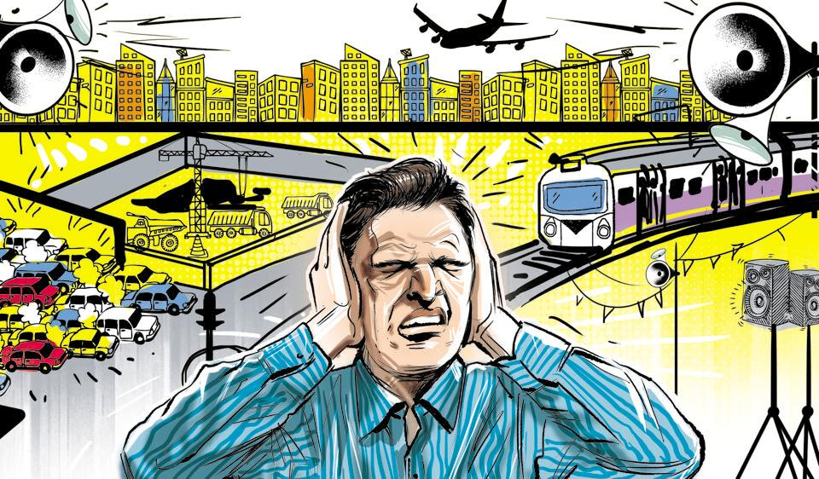
Producing Data: Noise
Less expensive and easier than other kinds of pollution to monitor continuously.
Public: direct sensory experience is privileged (mistrust in official data).
Fast reparations (but politically sensitive).

Slide 9
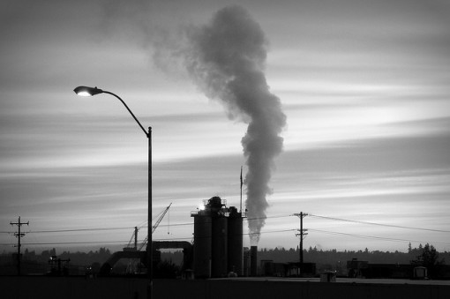
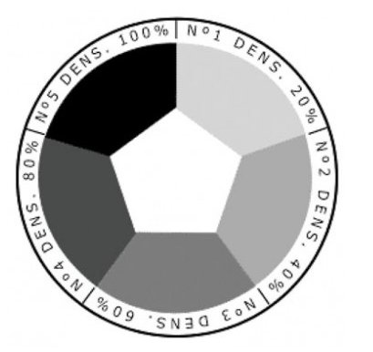
Producing Data: Air
Relatively cheap, limited basic pollutants.
Easy to monitor continuously.
But sensory experience is privileged by the public.
Visibile/invisible pollution
Reparations relatively fast.
Ringelmann Chart

Slide 10
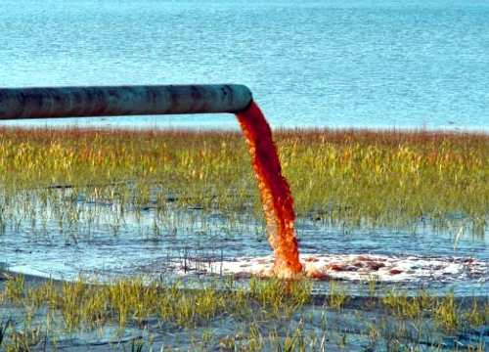
Producing Data: Water
Expensive to monitor continuously, high number of pollutants.
Distribution of stations with different pollutants.
Public’s sensory experience is not critical for trust.
Costly technology → path dependence, slow upgrades.
Slower, more long-term reparations.

Slide 11
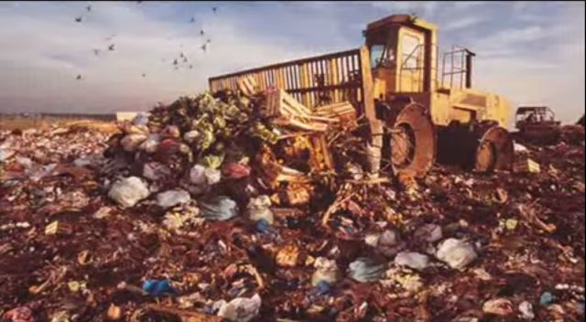
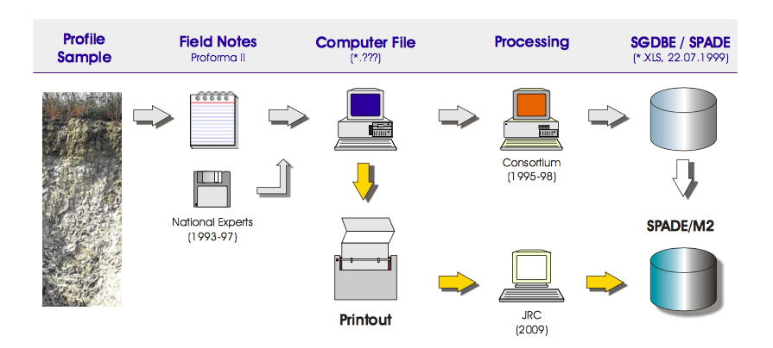
Producing Data: Soil
Hard to monitor in real time or continuously.
Costly and time-consuming.
Direct sensory experience is possible only in extreme cases.
Costly and slow reparations.

Slide 12
WHO MONITORS THE ENVIRONMENT?
State
Subnational Institutions
NGOs – Civil Society
Private Citizens
Supra-National Institutions

Slide 13
STANDARDIZING DATA
Environmental, measurement and disclosure standards.
Standards have always been contentious terrains for political struggles.
Cornerstone to the implementation of comprehensive, accessible, comparable datasets.
…but are also be leveraged (or perceived as being leveraged) to diminish competitors.
Dingwerth, K., & Eichinger, M. (2010). Tamed Transparency: How Information Disclosure under the Global Reporting Initiative Fails to Empower. Global Environmental Politics, 10(3), 74-+. doi:DOI 10.1162/GLEP_a_00015
Busch, L. (2011). Standards: Recipes for Reality: MIT Press.

Slide 14
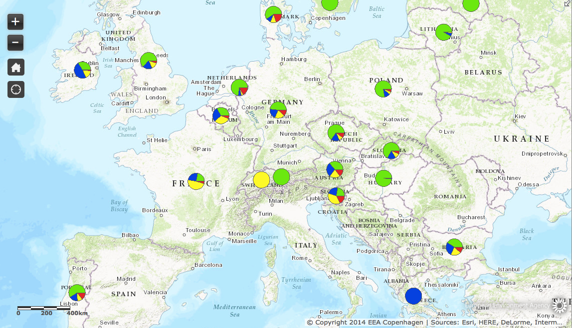
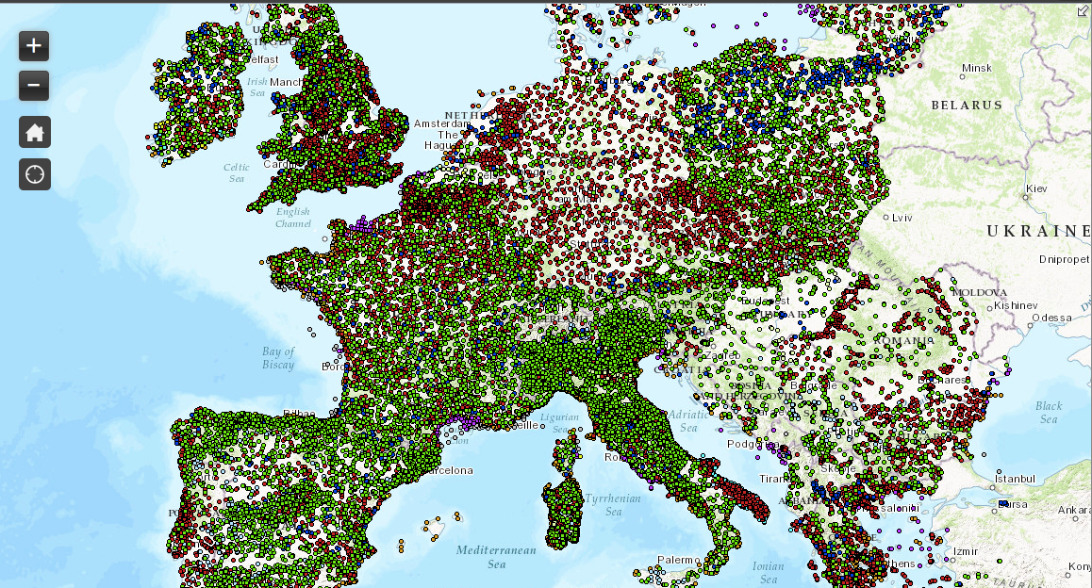
[this] situation [of fragmentation] of monitoring surface and ground water is determined probably by both technical and political problems.
In the EU, the Member States are responsible for monitoring the waters with more or less comparable approach. In Germany there are the Länder that operate the water monitoring.
Harmonization in the EU is also difficult because of the different stages of development of the monitoring systems. [Germany Environmental Ministry, Private Email, 2015]

Slide 15
COLLATING & Managing Data
Why are we monitoring?
Data have to be accessed to be able to influence decisions.
They have to be collated into databases and interfaces must be provided to query and parse them.
‘Data resolution’ (from synthetic indexes to real-time data) impacts access, usability, accountability.
Policymakers like synthetic, easy-to-digest, low-resolution data.
Citizens are expected to like continuous high-resolution data (but do they?).

Slide 16
FRICTIONS
Scientific Friction : ‘the difficulties encountered when two scientific disciplines working on related problems try to interoperate.’ (Edwards et al. 2011)
Data friction (Edwards, 2010): ‘what happens at the interfaces between data ‘surfaces’: the points where data move between people, substrates, organizations, or machines.’ (Edwards et al. 2011)
→ Multiple, divergent data points due to privileged LOCAL use.
Data friction increases cost; big data = big friction = huge costs
Metadata Friction: The costs of creation, handling, and managing metadata products.

